Slide 1











Student Grading Dataset Analysis
Steps:
Loading the dataset and exploring its structure.
Handling missing values and performing basic data cleaning.
Conducting exploratory data analysis (EDA) using visualizations.
Identifying correlations and patterns in student performance.
Presenting findings in a well-structured report.

Slide 2

1
Loading the dataset and exploring its structure

Slide 3

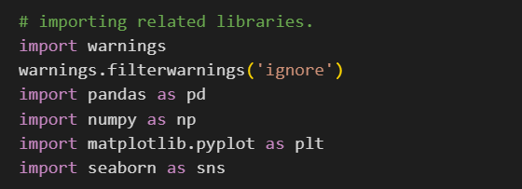
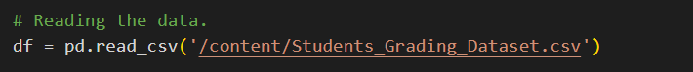



Loading the dataset and exploring its structure
Importing necessary libraries
Reading the data and exploring it
Getting sample from the data
Getting data information
Getting data description

Slide 4
2
Handling missing values and performing basic data cleaning.

Slide 5

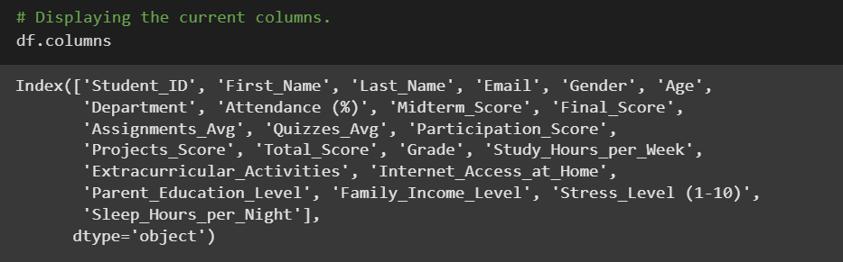
Handling missing values and performing basic data cleaning.
Step 1:
Removing unwanted columns.
For data analysis there are properties that doesn’t matter in analyzing the data like person names, phones or emails.
For our data:

Slide 6
Handling missing values and performing basic data cleaning.
Step 1:
Removing unwanted columns.
For our data:
we notice that there are columns like ID, Name, and Email, which are not required in our data analysis.
So, we will remove them
To make sure it will be applied to the data itself, not a view

Slide 7
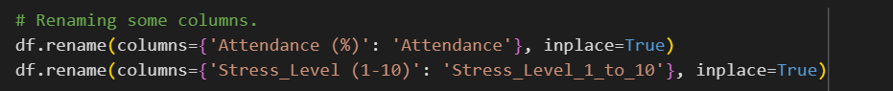
Handling missing values and performing basic data cleaning.
Step 2:
Renaming some columns
Sometimes, there are columns that have names which may make problems when using it in code, so I rename these columns with better names.
Attendance (%)
Attendance
Stress Level (1-10)
Stress_Level_1_to_10

Slide 8

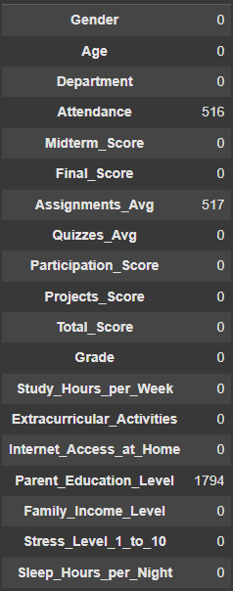
Handling missing values and performing basic data cleaning.
Step 3:
Dealing with null values.
We see the columns that have null values, then see if we remove these rows or fill them with the appropriate value.
Wee see that there are null values in Attendance, Assignment Avg, and Parent Education Level

Slide 9
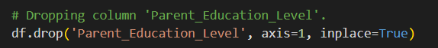
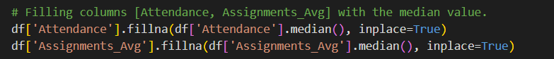
Handling missing values and performing basic data cleaning.
Step 3:
Dealing with null values.
We see the columns that have null values, then see if we remove these rows or fill them with the appropriate value.
For Parent Education Level:
It has about 20% of its values null values, so we will remove the entire column
For Attendance and Assignment Avg:
We will fill them with the median value.

Slide 10
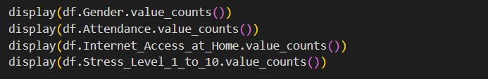
Handling missing values and performing basic data cleaning.
Step 4:
Making Sure there are no columns with only one value in all r0ws
If there are columns have a unified value in all rows, then it has no effect then, so it is better to remove it.
For our data:
There are no columns that have one value in all rows which is a good thing.

Slide 11
3
Conducting exploratory data analysis (EDA) using visualizations.

Slide 12

Conducting exploratory data analysis (EDA) using visualizations.
I will divide the visualizations into three parts:
Univariate Analysis
Bivariate Analysis
Multivariate Analysis

Slide 13

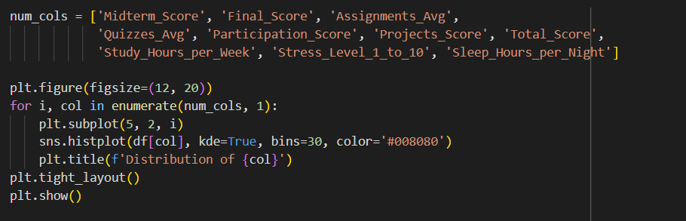
Conducting exploratory data analysis (EDA) using visualizations.
Univariate Analysis
This part shows the features of each single column to understand its distribution.
Numeric Columns

Slide 14
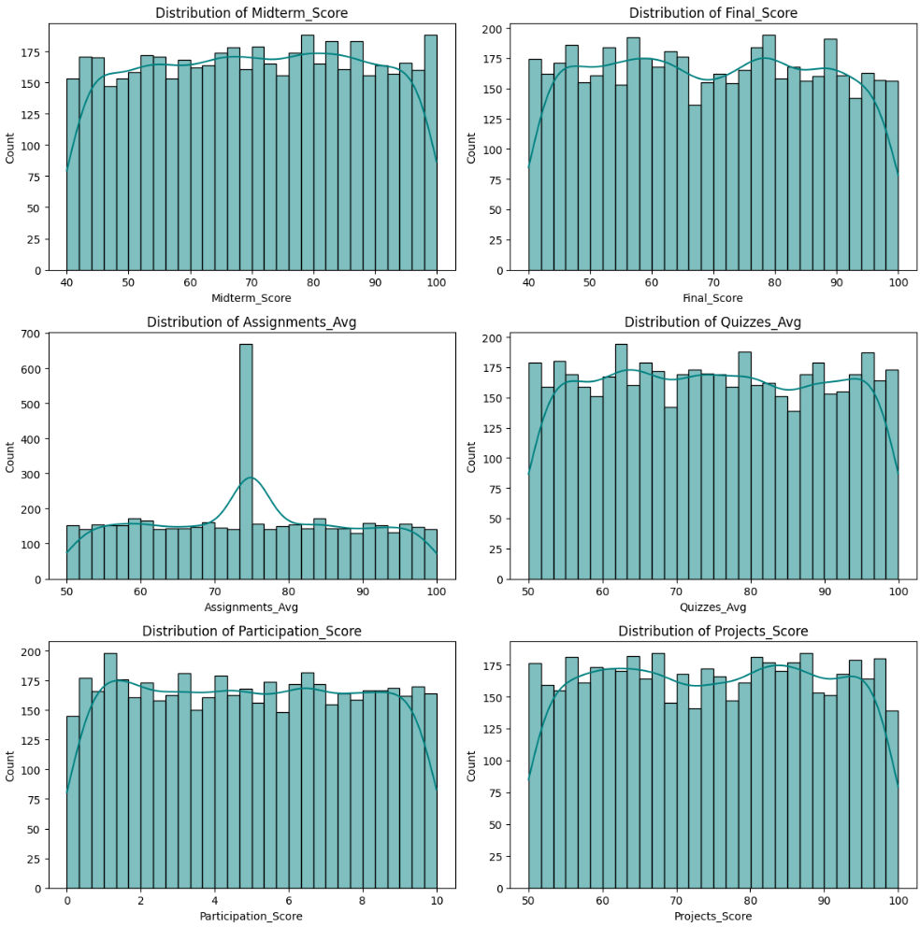
Conducting exploratory data analysis (EDA) using visualizations.
Univariate Analysis
Numeric Columns

Slide 15
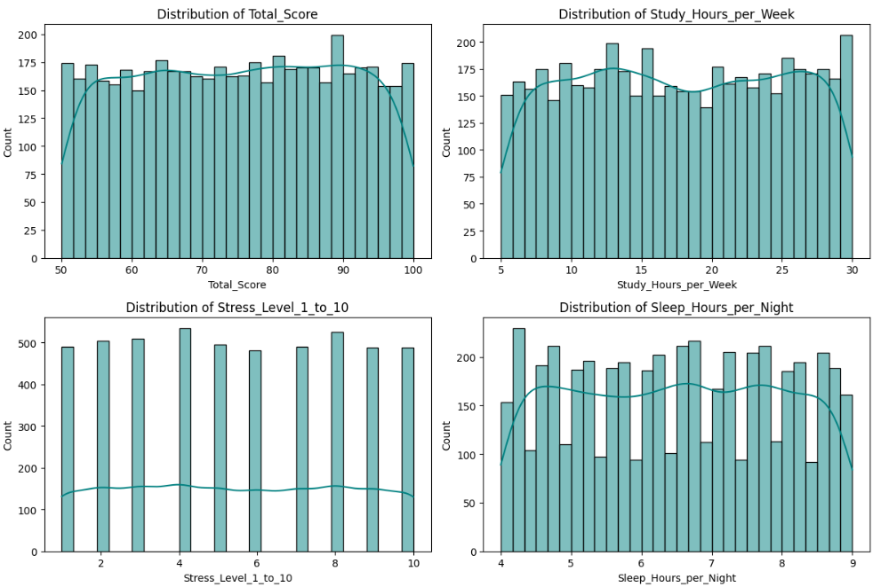
Conducting exploratory data analysis (EDA) using visualizations.
Univariate Analysis
Numeric Columns

Slide 16

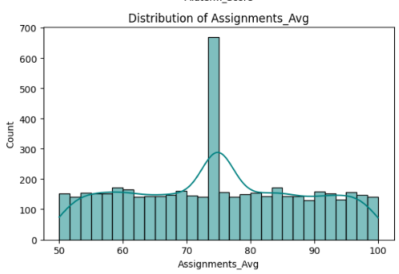
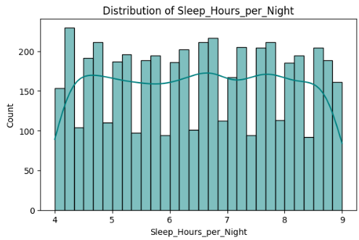
Conducting exploratory data analysis (EDA) using visualizations.
Univariate Analysis
Some Insights
Most columns exhibit a nearly uniform distribution from the minimum to the maximum value. However, Assignments Avg shows a concentration of values in the middle, while Sleep Hours per Night displays fluctuations in the number of hours.

Slide 17
Conducting exploratory data analysis (EDA) using visualizations.
Univariate Analysis
Some Insights
There are few to no outliers detected in these distributions.
Overall, the univariate distribution of numerical values does not present significant variations, as most of them follow a uniform pattern.

Slide 18
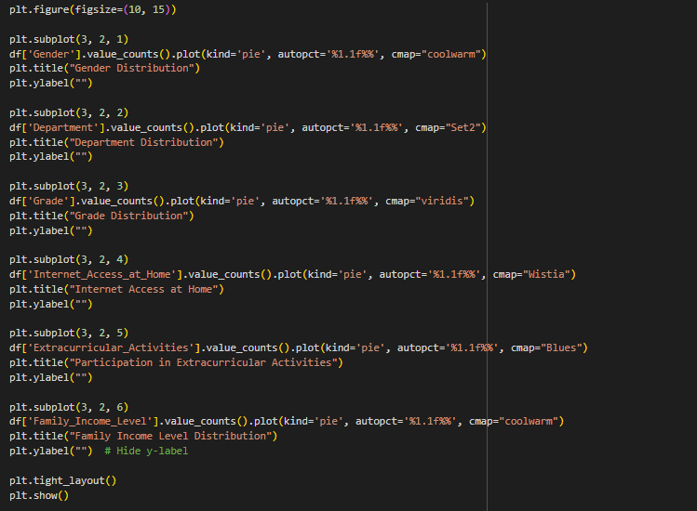
Conducting exploratory data analysis (EDA) using visualizations.
Univariate Analysis
This part shows the features of each single column to understand its distribution.
Categorical Columns

Slide 19
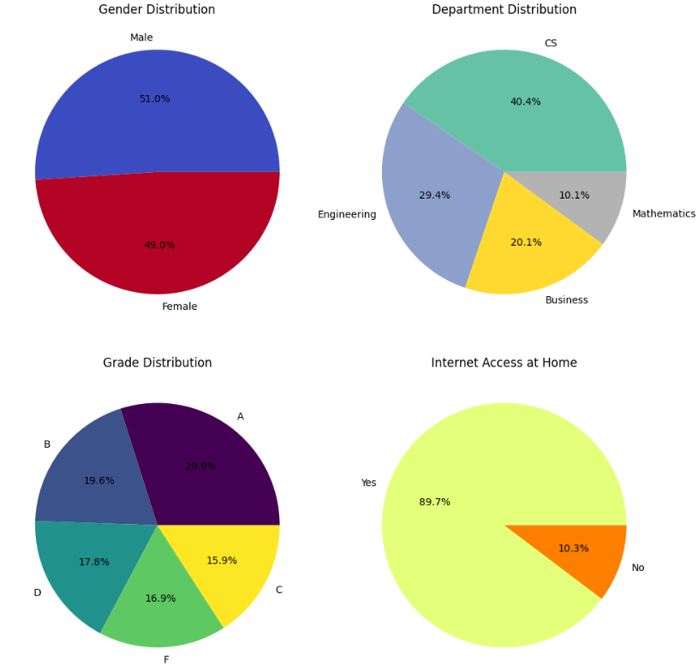
Conducting exploratory data analysis (EDA) using visualizations.
Univariate Analysis
Categorical Columns
The categorical columns show variations in the number of values for each category

Slide 20
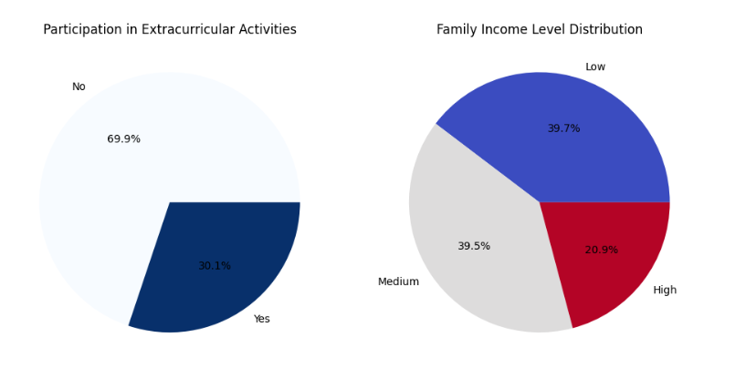
Conducting exploratory data analysis (EDA) using visualizations.
Univariate Analysis
Categorical Columns
The categorical columns show variations in the number of values for each category

Slide 21
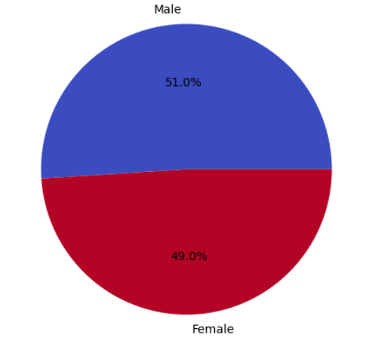
Conducting exploratory data analysis (EDA) using visualizations.
Univariate Analysis
Some Insights
Gender: The number of male and female students is nearly equal.

Slide 22
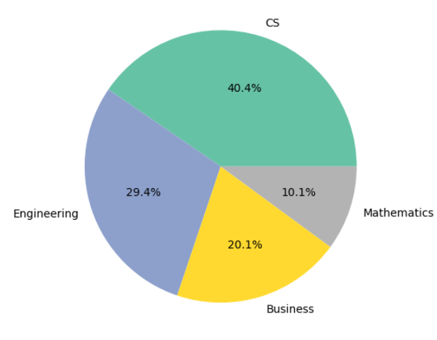
Conducting exploratory data analysis (EDA) using visualizations.
Univariate Analysis
Some Insights
Department: The Computer Science department has the highest enrollment, while Mathematics has the lowest.

Slide 23
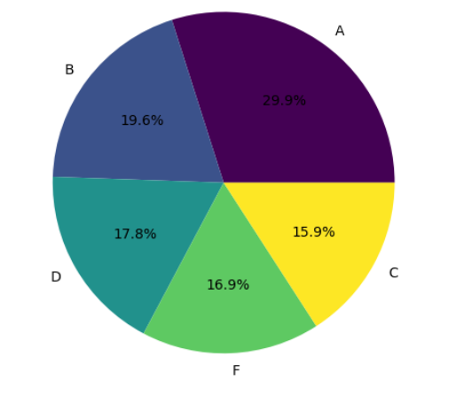
Conducting exploratory data analysis (EDA) using visualizations.
Univariate Analysis
Some Insights
Grade: Around 30% of students received Grade A, while the remaining grades are distributed almost equally among the other students.

Slide 24
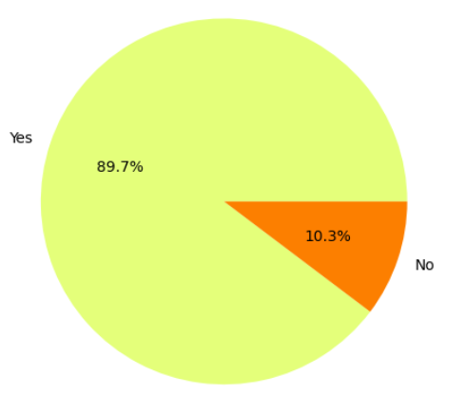
Conducting exploratory data analysis (EDA) using visualizations.
Univariate Analysis
Some Insights
Internet Access at Home: About 90% of students have internet access at home, though the lack of access for some students could be a concern.

Slide 25
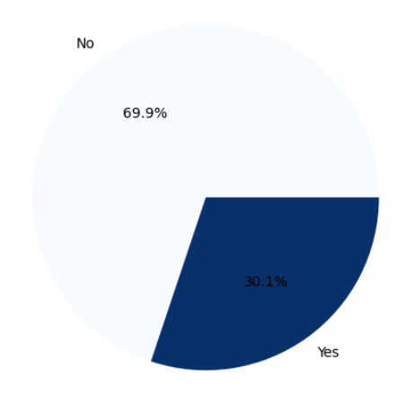
Conducting exploratory data analysis (EDA) using visualizations.
Univariate Analysis
Some Insights
Participation in Extracurricular Activities: Only 30% of students participate in extracurricular activities, which is a relatively low percentage.

Slide 26
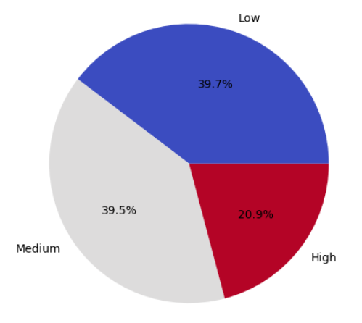
Conducting exploratory data analysis (EDA) using visualizations.
Univariate Analysis
Some Insights
Family Income Level: Around 80% of students' families fall into the low-to-medium income range, while only 20% come from high-income families.

Slide 27
Conducting exploratory data analysis (EDA) using visualizations.
I will divide the visualizations into three parts:
Univariate Analysis
Bivariate Analysis
Multivariate Analysis

Slide 28

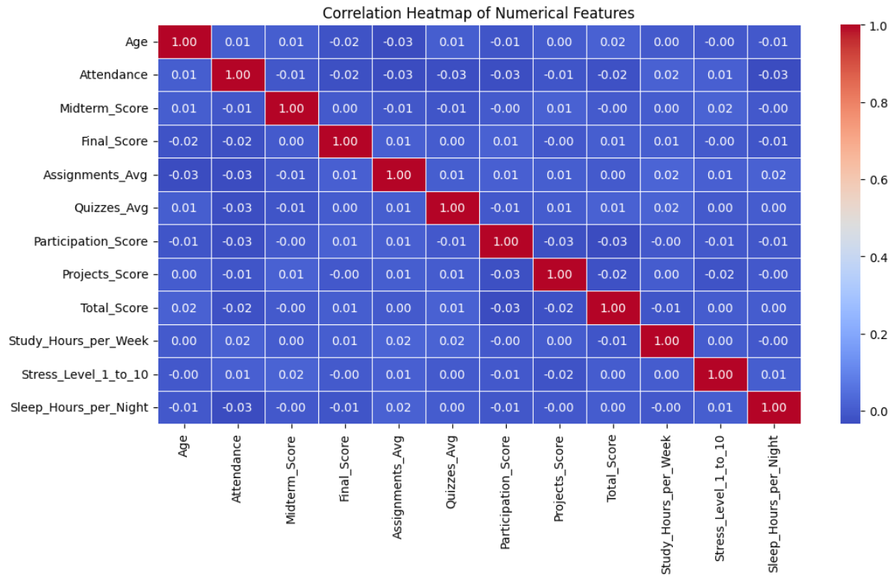
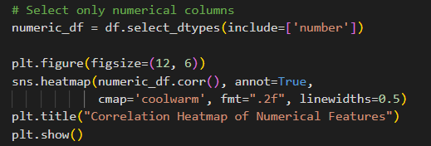
Conducting exploratory data analysis (EDA) using visualizations.
Bivariate Analysis
This part shows relations between some pairs of related properties
Correlation between numeric columns

Slide 29
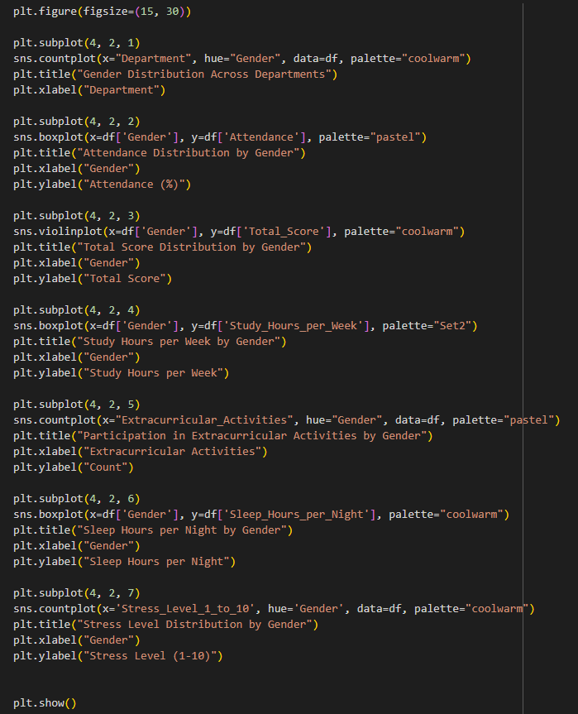
Conducting exploratory data analysis (EDA) using visualizations.
Bivariate Analysis
Then, Let’s take properties one by one and try to extract its features with other columns
Gender
Department
Attendance
Total Score
Study hours per week
Extracurricular activities
Sleep Hours per night
Stress Level

Slide 30
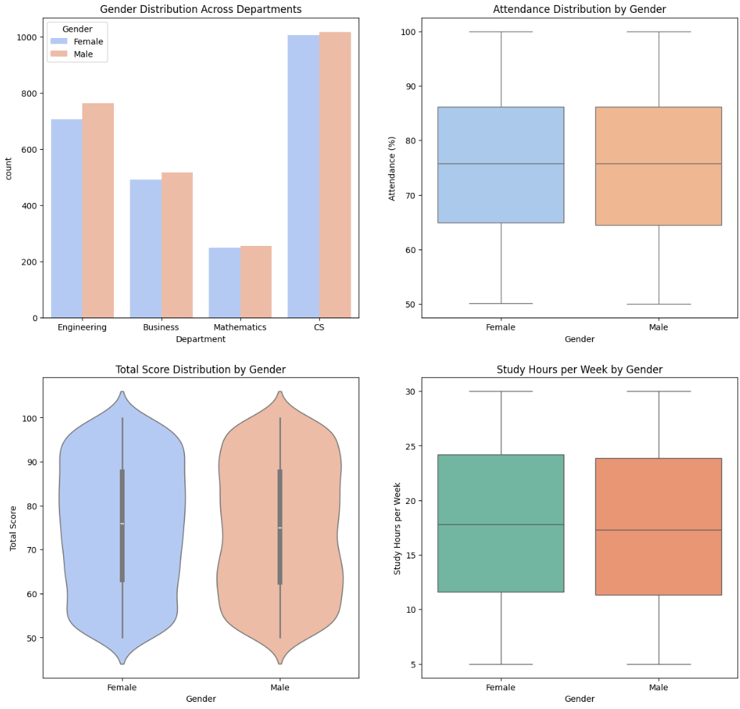
Conducting exploratory data analysis (EDA) using visualizations.
Bivariate Analysis
Gender
Department
Attendance
Total Score
Study hours per week

Slide 31
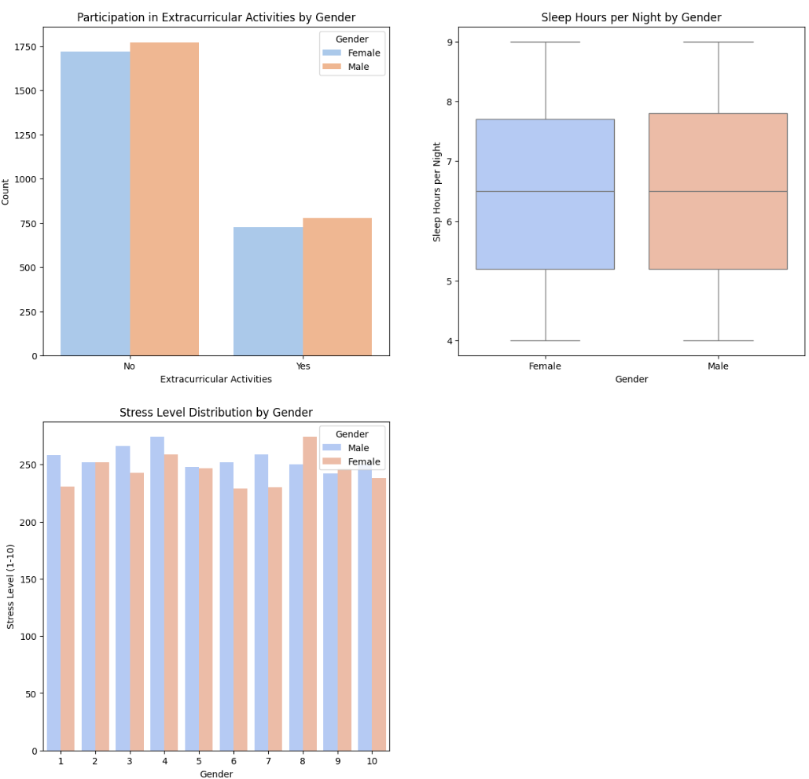
Conducting exploratory data analysis (EDA) using visualizations.
Bivariate Analysis
Gender
Extracurricular activities
Sleep Hours per night
Stress Level

Slide 32

Conducting exploratory data analysis (EDA) using visualizations.
Bivariate Analysis
Some Insights
After analyzing the relationships between Gender and relevant columns (Department, Attendance, Total Score, Study Hours per Week, Extracurricular Activities, Sleep Hours per Night, and Stress Level), we observed the following:
In most aspects, both males and females exhibit similar patterns, with no significant differences in distribution.
However, a noticeable trend appears in stress levels—females tend to be higher stress more frequently, particularly in the upper ranges (8 and 9).
Ideas
Try to lower the stress of girls by increasing their awareness from teachers.

Slide 33
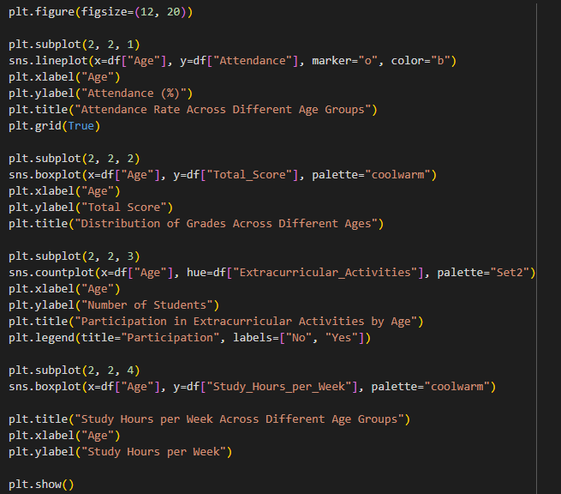
Conducting exploratory data analysis (EDA) using visualizations.
Bivariate Analysis
Age
Attendance
Total Score
Extracurricular activities
Study hours per week

Slide 34
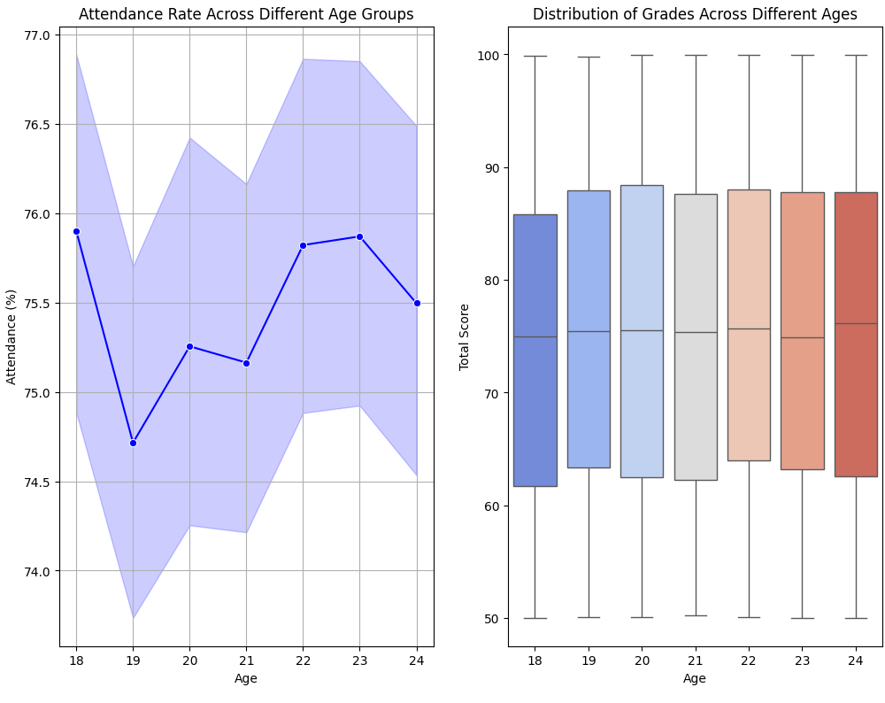
Conducting exploratory data analysis (EDA) using visualizations.
Bivariate Analysis
Age
Attendance
Total Score

Slide 35
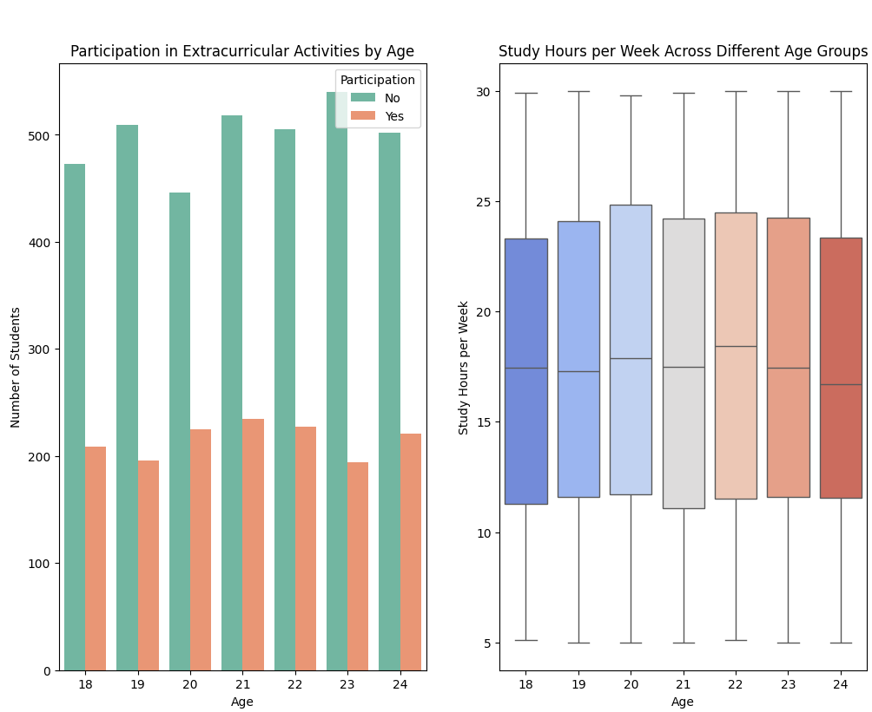
Conducting exploratory data analysis (EDA) using visualizations.
Bivariate Analysis
Age
Extracurricular activities
Study hours per week

Slide 36
Conducting exploratory data analysis (EDA) using visualizations.
Bivariate Analysis
Some Insights
After analyzing the relationships between Age and relevant columns (attendance, grade, extracurricular activity, study hours per week), we observed the following:

Slide 37
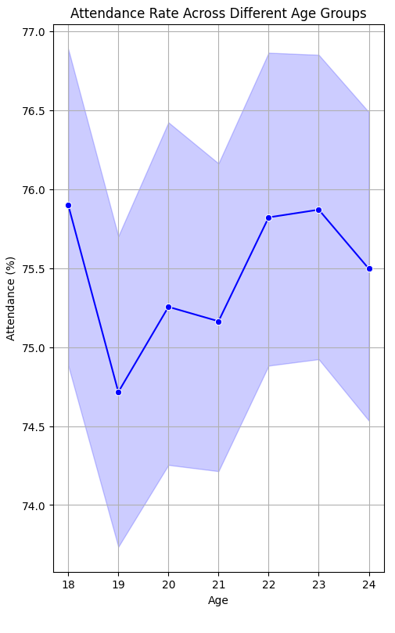
Conducting exploratory data analysis (EDA) using visualizations.
Bivariate Analysis
Some Insights
Attendance : There is a slight difference in the distribution between ages, but the attendance percentage starts big at the first ages, decreases a little after this and increases again.

Slide 38
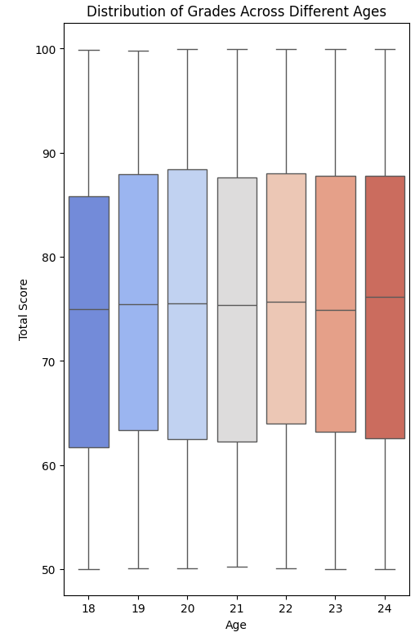
Conducting exploratory data analysis (EDA) using visualizations.
Bivariate Analysis
Some Insights
Total Score : The percentage of total scores is nearly the same between all ages, but we notice that at the first year, the maximum score is lower than other years, and this maybe due to the unclear knowledge for the first-year students.

Slide 39
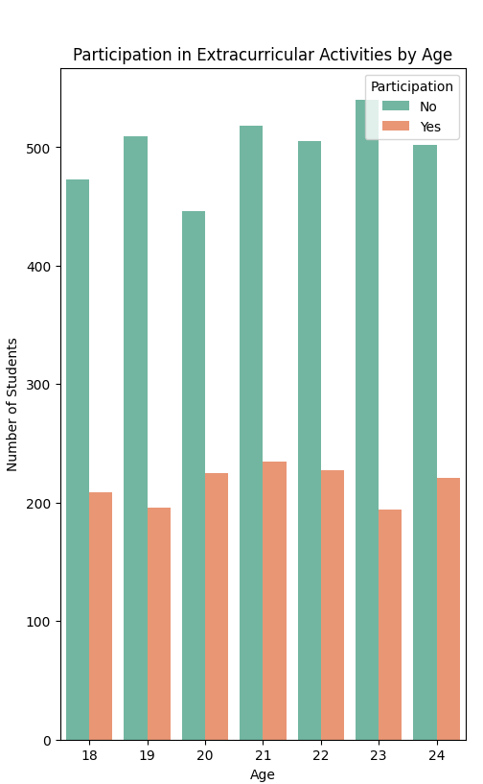
Conducting exploratory data analysis (EDA) using visualizations.
Bivariate Analysis
Some Insights
Participation in Extracurricular activities : we notice that these activities decreases a little at the year before the last and are bigger in middle years. This is maybe due to that the year before the last is much difficult than other year.

Slide 40
Conducting exploratory data analysis (EDA) using visualizations.
Bivariate Analysis
Some Insights
Study hours per week : Nearly most of ages have the same distribution.

Slide 41
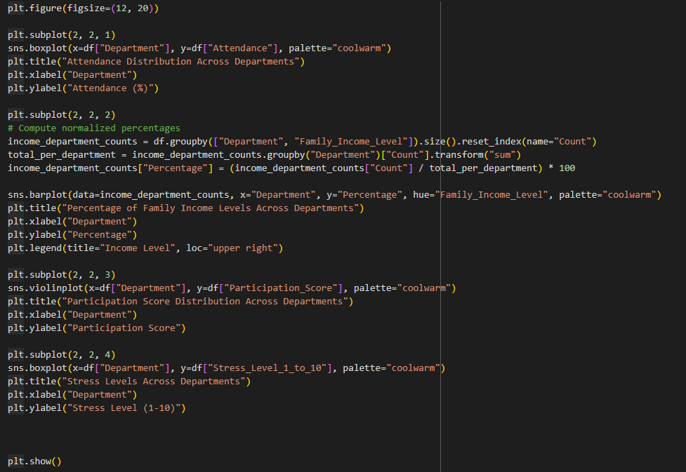
Conducting exploratory data analysis (EDA) using visualizations.
Bivariate Analysis
Department
Attendance
Family income level
Participation Score
Stress level

Slide 42
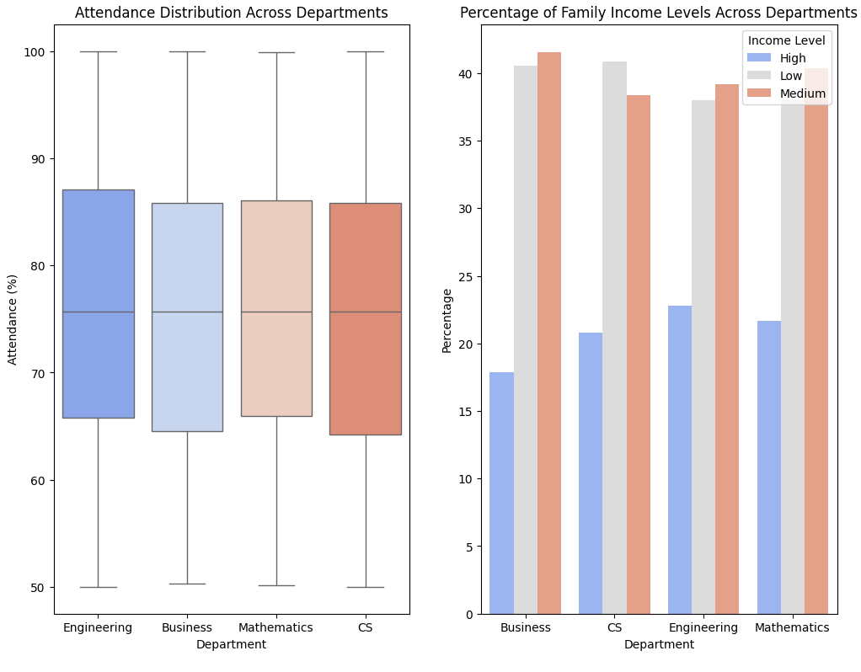
Conducting exploratory data analysis (EDA) using visualizations.
Bivariate Analysis
Department
Attendance
Family income level

Slide 43
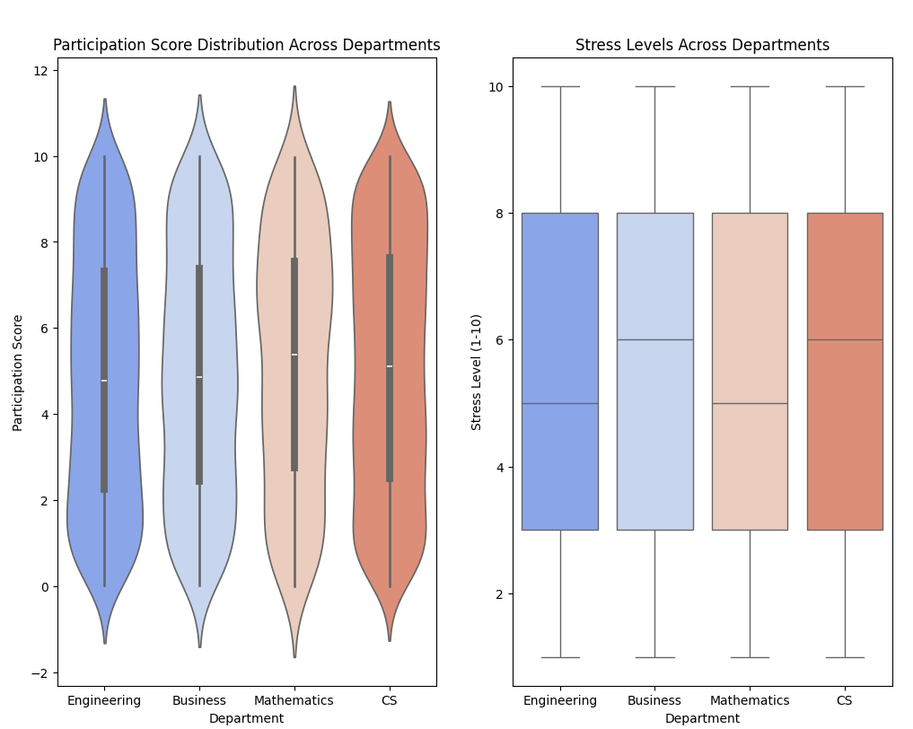
Conducting exploratory data analysis (EDA) using visualizations.
Bivariate Analysis
Department
Participation Score
Stress level

Slide 44
Conducting exploratory data analysis (EDA) using visualizations.
Bivariate Analysis
Some Insights
Attendance : There is no significant difference in attendance across different departments, which is a positive aspect.

Slide 45
Conducting exploratory data analysis (EDA) using visualizations.
Bivariate Analysis
Some Insights
Family Income: Students from high-income families tend to prefer the Engineering department over others.

Slide 46
Conducting exploratory data analysis (EDA) using visualizations.
Bivariate Analysis
Some Insights
Participation Score: The highest participation scores are observed in the Mathematics department, suggesting that other departments could learn from the teaching strategies used in this field.

Slide 47
Conducting exploratory data analysis (EDA) using visualizations.
Bivariate Analysis
Some Insights
Stress Level: Stress levels are notably higher in both the Business and Computer Science departments, highlighting the need to investigate the underlying causes.

Slide 48
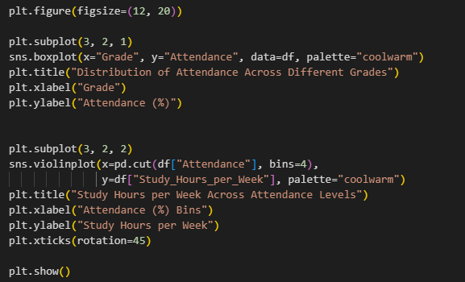
Conducting exploratory data analysis (EDA) using visualizations.
Bivariate Analysis
Attendance
Grade
Study hours per week

Slide 49
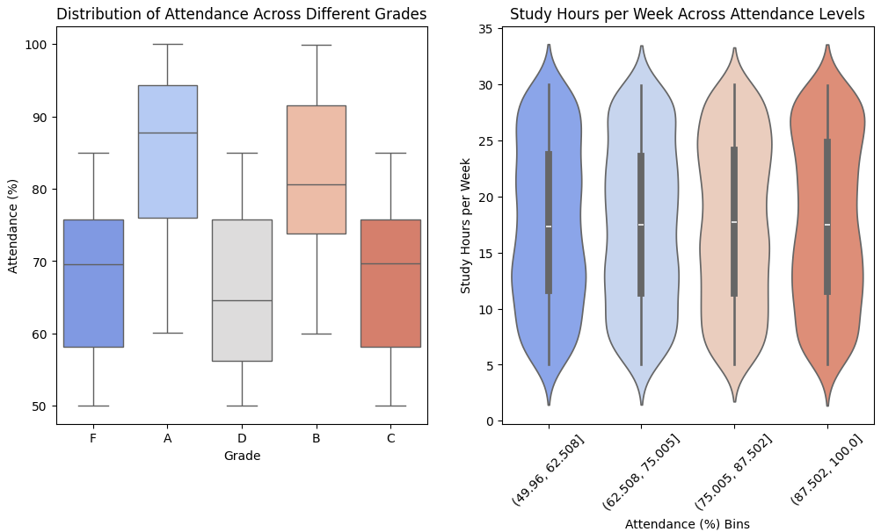
Conducting exploratory data analysis (EDA) using visualizations.
Bivariate Analysis
Attendance
Grade
Study hours per week

Slide 50
Conducting exploratory data analysis (EDA) using visualizations.
Bivariate Analysis
Some Insights
Grades: A strong correlation is observed between attendance and grades—students with higher attendance tend to achieve better grades.

Slide 51
Conducting exploratory data analysis (EDA) using visualizations.
Bivariate Analysis
Some Insights
Study Hours per Week: Most students study for a similar number of hours each week. However, those who attend classes regularly tend to secure higher grades despite studying the same amount as those with lower attendance.

Slide 52
Conducting exploratory data analysis (EDA) using visualizations.
Bivariate Analysis
Encourage students to attend classes regularly, as it significantly improves their grades without requiring additional study hours compared to those who attend less frequently.
Ideas

Slide 53
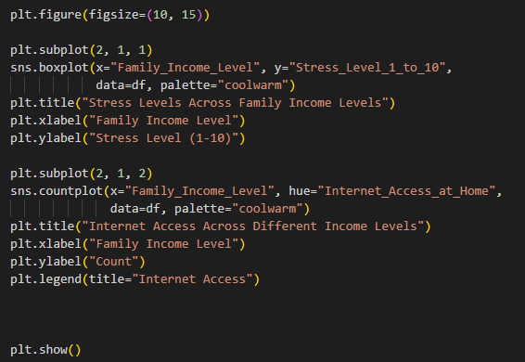
Conducting exploratory data analysis (EDA) using visualizations.
Bivariate Analysis
Family Income
Stress Level
Internet Access at Home

Slide 54
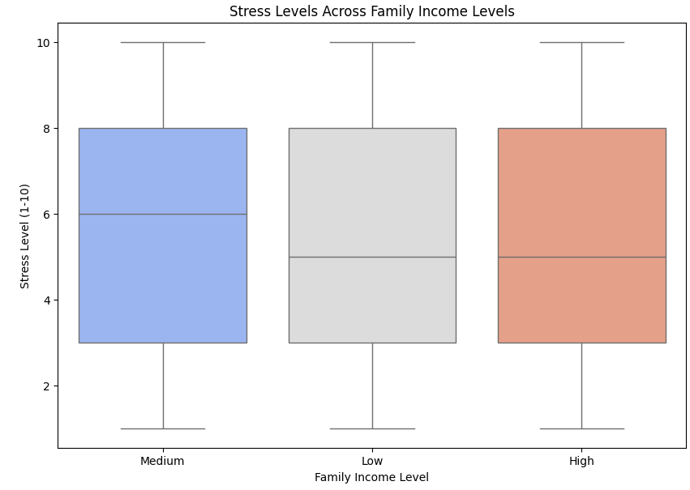
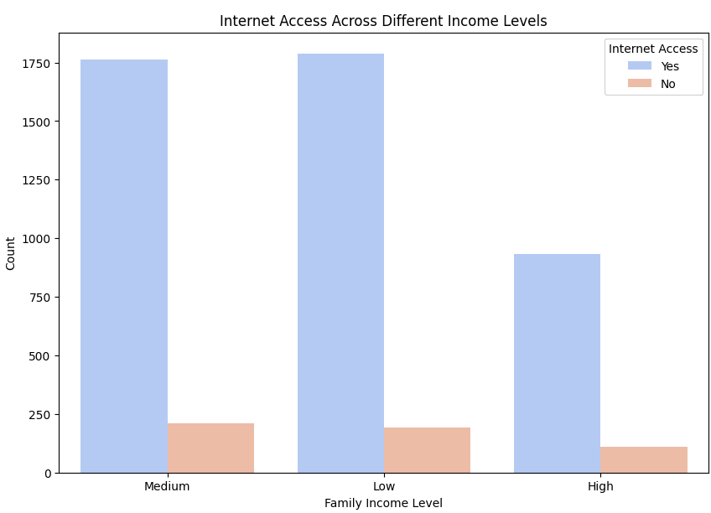
Conducting exploratory data analysis (EDA) using visualizations.
Bivariate Analysis
Family Income
Stress Level
Internet Access at Home

Slide 55
Conducting exploratory data analysis (EDA) using visualizations.
Bivariate Analysis
Some Insights
Stress Level: We observe that stress levels are highest among students from middle-income families.

Slide 56
Conducting exploratory data analysis (EDA) using visualizations.
Bivariate Analysis
Some Insights
Internet Access: The visualization indicates no direct relationship between family income and internet access, as all income levels have nearly the same percentage of internet availability.

Slide 57
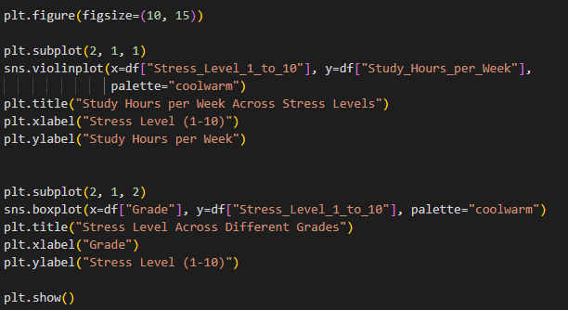
Conducting exploratory data analysis (EDA) using visualizations.
Bivariate Analysis
Stress
Study Hours per Week
Grade

Slide 58
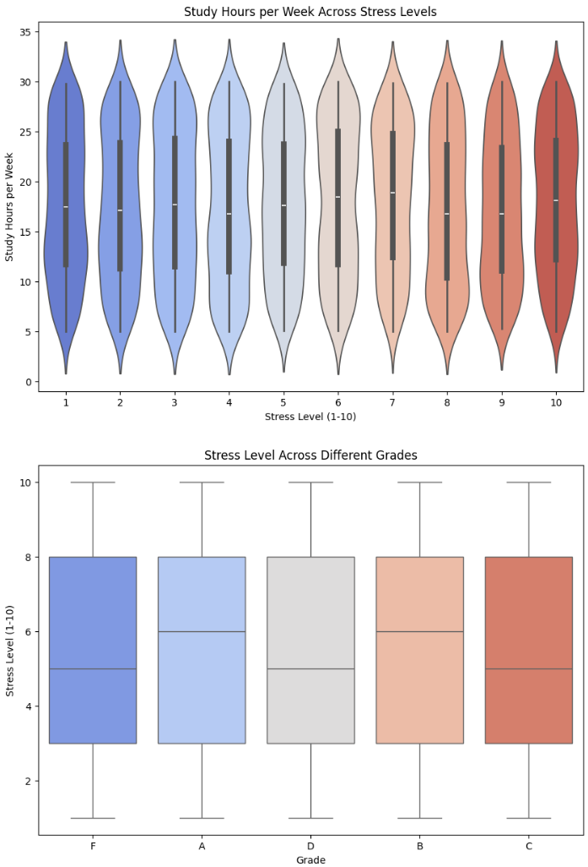
Conducting exploratory data analysis (EDA) using visualizations.
Bivariate Analysis
Stress
Study Hours per Week
Grade

Slide 59
Conducting exploratory data analysis (EDA) using visualizations.
Bivariate Analysis
Some Insights
Study Hours per Week: We notice that there is no clear relationship between stress levels and the number of study hours per week, as the data shows fluctuations.

Slide 60
Conducting exploratory data analysis (EDA) using visualizations.
Bivariate Analysis
Some Insights
Grades: Students who achieved Grade A or Grade B tend to have higher stress levels compared to others, but their stress is not extremely high.

Slide 61
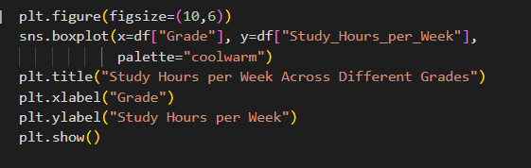
Conducting exploratory data analysis (EDA) using visualizations.
Bivariate Analysis
Grades
Study Hours per Week

Slide 62
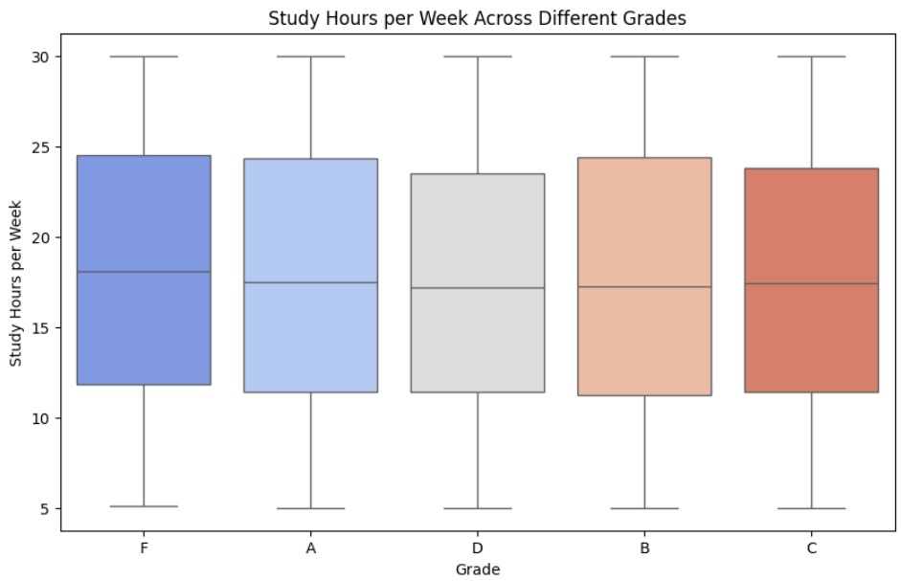
Conducting exploratory data analysis (EDA) using visualizations.
Bivariate Analysis
Grades
Study Hours per Week

Slide 63
Conducting exploratory data analysis (EDA) using visualizations.
Bivariate Analysis
Some Insights
For this visualization we notice that there is no relation between Grades and number of studying hours per week.
We notice that students that got grade A study the same number of hours like students who got grade F.

Slide 64
Conducting exploratory data analysis (EDA) using visualizations.
Bivariate Analysis
Let students notice that the grade doesn't increase by the increase of number of studying hours, but how to study.
Ideas

Slide 65
Conducting exploratory data analysis (EDA) using visualizations.
I will divide the visualizations into three parts:
Univariate Analysis
Bivariate Analysis
Multivariate Analysis

Slide 66

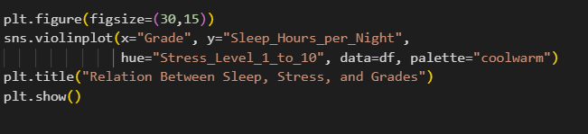
Conducting exploratory data analysis (EDA) using visualizations.
Multivariate Analysis
This part shows relations between many columns at the same time.
Stress, Sleep Hours & Grades

Slide 67
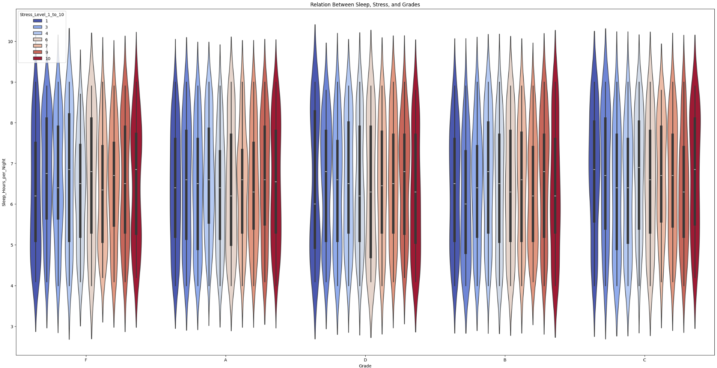
Conducting exploratory data analysis (EDA) using visualizations.
Multivariate Analysis
This part shows relations between many columns at the same time.
Stress, Sleep Hours & Grades

Slide 68
Conducting exploratory data analysis (EDA) using visualizations.
Multivariate Analysis
It is shown that Most of students who got High Grades slept about 6 to 7 hours and were not much stressed.
Some Insights

Slide 69
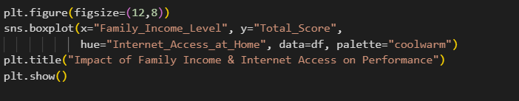
Conducting exploratory data analysis (EDA) using visualizations.
Multivariate Analysis
Family Income, Internet Access & Total Score

Slide 70
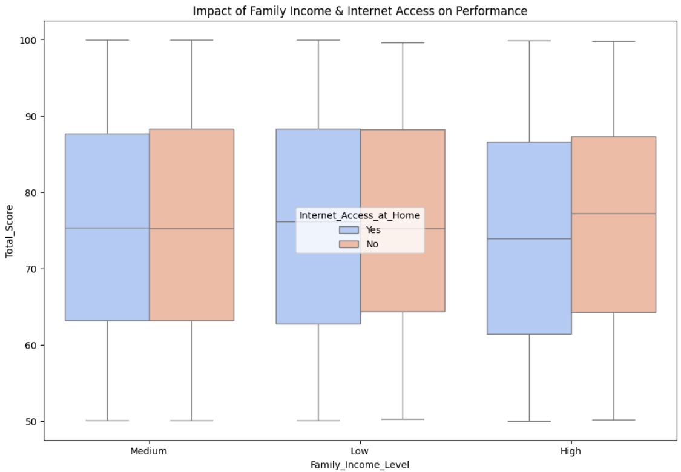
Conducting exploratory data analysis (EDA) using visualizations.
Multivariate Analysis
Family Income, Internet Access & Total Score

Slide 71
Conducting exploratory data analysis (EDA) using visualizations.
Multivariate Analysis
Some Insights
We note that the absence of internet access doesn't affect the scores of students, so the internet is not a big deal in the process of getting high degrees, and it is not a sign for the high-income family, such that the biggest percentage for the absence of internet is found in the high-income families.

Slide 72
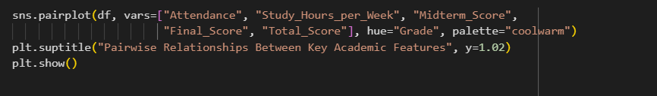
Conducting exploratory data analysis (EDA) using visualizations.
Multivariate Analysis
Some columns taking ‘Grade’ in considerations

Slide 73

Conducting exploratory data analysis (EDA) using visualizations.
Multivariate Analysis
Some columns taking ‘Grade’ in considerations

Slide 74
Conducting exploratory data analysis (EDA) using visualizations.
Multivariate Analysis
Some Insights
we notice that the biggest effect in getting high Grade is the attendance. The more you attend the more you got highest degrees.

Slide 75

Conducting exploratory data analysis (EDA) using visualizations.
Multivariate Analysis
Study Hours, Sleep Hours & Stress Level

Slide 76

Conducting exploratory data analysis (EDA) using visualizations.
Multivariate Analysis
Study Hours, Sleep Hours & Stress Level

Slide 77
Conducting exploratory data analysis (EDA) using visualizations.
Multivariate Analysis
Some Insights
We notice that the lowest degree of stress found when you take enough hours of sleep (from 6 to 8) and study for enough hours per week (30 and above).

Slide 78

Conducting exploratory data analysis (EDA) using visualizations.
Multivariate Analysis
Attendance, Hours Studied per Week & Grades

Slide 79

Conducting exploratory data analysis (EDA) using visualizations.
Multivariate Analysis
Attendance, Hours Studied per Week & Grades

Slide 80
Conducting exploratory data analysis (EDA) using visualizations.
Multivariate Analysis
Some Insights
It is noticed that the students who attend more got the highest degrees even if they study the same hours as other students.

Slide 81




Ideas for improving students Grades.
Improve the quality of teaching in Mathematics field which is the least in enrollment in all fields.
Increasing awareness of students to participate in extracurricular activities, such that this increases their social skills.
Working on lowering the stress of girls.

Slide 82



Ideas for improving students Grades.
Encourage students to attend classes regularly, as it significantly improves their grades without requiring additional study hours compared to those who attend less frequently.
Getting high Grades (A, or B) doesn’t mean student must be high stressed, as students who got these grades were not at the high level of stress. So, students must be aware by that.
Let students notice that the grade doesn't increase by the increase of number of studying hours, but how to study.

Slide 83


Ideas for improving students Grades.
Most students who got high grades slept about from 6 to 8 hours, so little sleep or over sleeping are not the best decision to get high grades.
Being a high-income family doesn’t mean you have internet available which is show in the data, and having internet access doesn’t mean you get high grades, so Getting high grades doesn’t depend on the availability of the internet, so students who don’t have the ability to be accessed to internet must be aware that they can achieve what they want even if they are not accessed to the internet.

Slide 84


Ideas for improving students Grades.
It is noticed that the lowest degree of stress found when you take enough hours of sleep (from 6 to 8) and study for enough hours per week (30 and above).
After noticing all the properties in relation with getting high scores, we noticed that the biggest effect in getting high Grades is the attendance. The more you attend the more you got highest degrees.

Slide 85
Thank you

